Slide 1
VAE and Batch Size
Presenter: Kim Seung Hwan (overnap@khu.ac.kr)

Slide 2
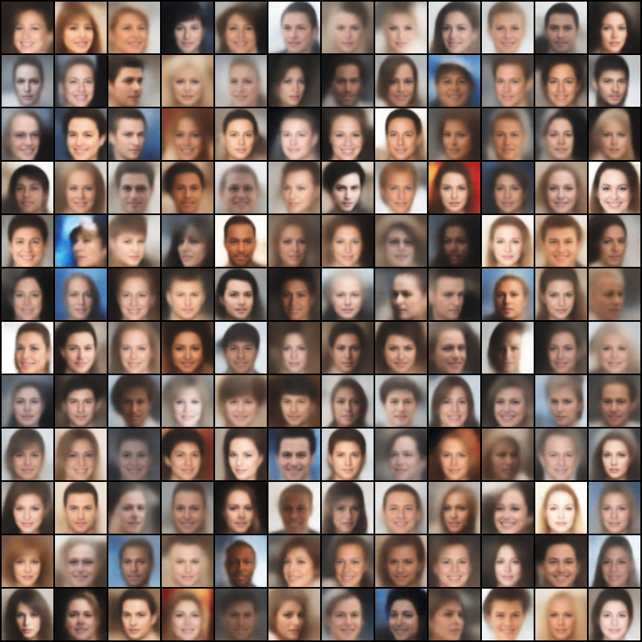
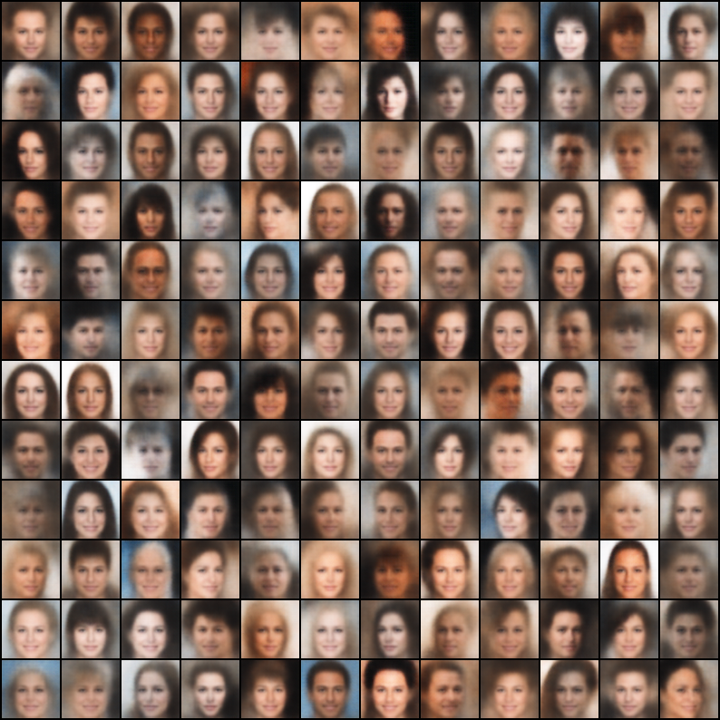
Which sample do you think is better?

Slide 3
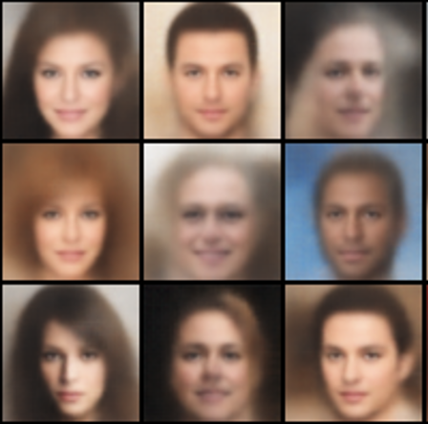
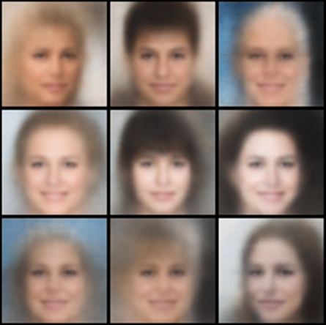
Batch size and performance
Obtained by using the same VAE model with different batch sizes
Left is from 64, right is from 2048

Slide 4

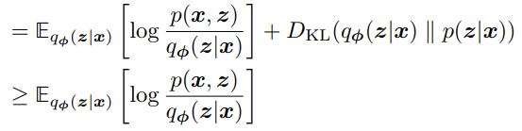
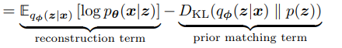
Batch size and performance
It looks more like an average face
I think this is because regularization becomes stronger
(but experimental verification required…)
true posterior matching term
ELBO

Slide 5
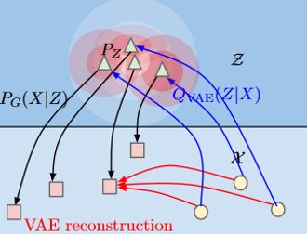
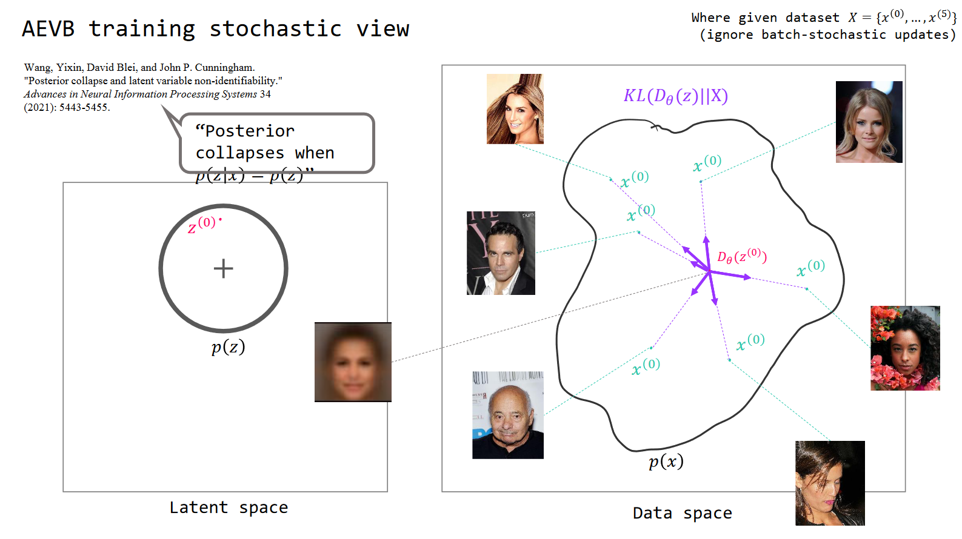
Reconstruction vs. Regularization
true posterior matching term
ELBO

Slide 6
Goal
How to verify that regularization is stronger than reconstruction?
Even with this problem, why should the batch size be increased?
Solution

Slide 7
Thank you for listening
Presenter: Kim Seung Hwan (overnap@khu.ac.kr)

